Slide 1
Machine Learning
Lecture 9:
K-nearest-neighbor
Dr. Beilun Wang
Southeast University
School of Computer Science
and Engineering

Slide 2
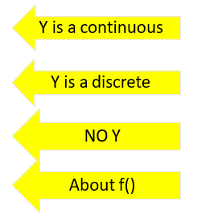
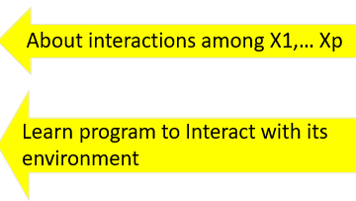
Course Content Plan
Six major sections of this course
❑ Regression (supervised)
❑ Classification (supervised)
❑ Unsupervised models
❑ Learning theory
❑ Graphical models
Reinforcement Learning

Slide 3
Last: Supervised Classifiers
 |  | Classification Separation Boundary / Tree Local Smooth / Generative ? ? ACC / F1 / Many metric
Task Representation Score Function Search/Optimization Models, Parameters
Task: y
Output Y is categorical
Representation:
x, f()
Score Function: L()
Search/Optimization
: argmin()
Models, Parameters :

Slide 4
Three major sections for classification
We can divide the large variety of classification approaches into roughly three major types
Discriminative
directly estimate a decision rule/boundary
e.g., support vector machine, decision tree, logistic regression
e.g. neural networks (NN), deep NN
Generative
build a generative statistical model
e.g., Bayesian networks, Naïve Bayes classifier
Instance based classifiers
Use observation directly (no models)
e.g. K nearest neighbors

Slide 5
Today: K-Nearest Neighbor
 |  | Classification / Regression Local Smoothness EPE with L2 loss ➔ conditional mean (Extra) NA Training Samples
Task Representation Score Function Search/Optimization Models, Parameters
Task: y
Representation:
x, f()
/ training samples
Score Function: L()
Search/Optimization
: argmin()
Models, Parameters :

Slide 6


Example: Majority Vote
Dog
？
Cat
Dog

Slide 7
Example: Vector Space Representation of Text
Each document is a vector, one component for each term (= word).
High-dimensional vector space:
Terms are axes, 10,000+ dimensions, or even 100,000+
Docs are vectors in this space
Normally normalize to unit length.
 | Doc 1 | Doc 2 | Doc 3 | ...
Word 1 | 3 | 0 | 0 | ...
Word 2 | 0 | 8 | 1 | ...
Word 3 | 12 | 1 | 10 | ...
... | 0 | 1 | 3 | ...
... | 0 | 0 | 0 | ...

Slide 8



Multiple Classes in a Vector Space
Sports
Science
Arts

Slide 9
Test document = ?
?
Sports
Science
Arts

Slide 10
K-Nearest Neighbor (kNN) classifier
?
Sports
Science
Arts

Slide 11
Instance-based Learning
Simplest form of learning:
Training instances are searched for those that most closely resembles new instance
The instances themselves represent the knowledge
Similarity function defines what’s “learned”
Instance-based learning is lazy learning

Slide 12
Instance-based Learning
K-Nearest Neighbor Algorithm
Weighted Regression
Case-based reasoning

Slide 13
What makes an Instance-Based Learner?
A distance metric
How to relate to the local points?
How many nearby neighbors to look at?
A weighting function (optional)

Slide 14
Popular Distance Metric
Euclidean:
Or equivalently:
Other metrics:
L₁ norm: |x-x'|
L∞ norm: max |x-x'| (elementwise …)
Mahalanobis: where Σ is full, and symmetric
Correlation
Angle
Hamming distance, Manhattan distance
…
∑
σ (x − x ')
D(x, x') =
2
2
i i i
i
D(x, x') =
(x − x')^{T} Σ(x − x')

Slide 15
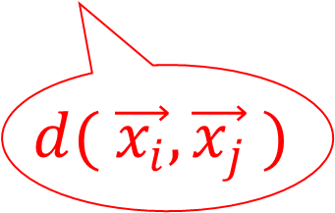
Feature Scaling in Nearest Neighbor method
Scaling issues
Attributes may have to be scaled to prevent distance measures from being dominated by one of the attributes
Example:
height of a person may vary from 1.5 m to 1.9 m
weight of a person may vary from 50 kg to 100 kg
income of a person may vary from ￥3K to ￥100W
The relative scalings in the distance metric affect region shapes.
$$d( \vec{x_{i}},\vec{x_{j}} )$$

Slide 16
What makes an Instance-Based Learner?
A distance metric
How to relate to the local points?
How many nearby neighbors to look at?
A weighting function (optional)

Slide 17

Nearest Neighbor is instance-based method
x₂
Unknown record
Requires three inputs:
The set of stored training samples
Distance metric to compute distance between samples
The value of k, i.e., the number of nearest neighbors to retrieve
x₁
y∈{＋, －}

Slide 18
Nearest Neighbor classifiers
x₂
Unknown record
To classify unknown sample:
Compute distance to training records
Identify k nearest neighbors
Use class labels of nearest neighbors to determine the class label of unknown record (e.g., by taking majority vote)
x₁

Slide 19

Example: 1-Nearest Neighbor
K=1
? Black

Slide 20
Example: 3-Nearest Neighbor
K=3
? Yellow

Slide 21
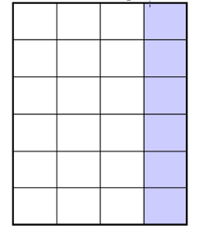

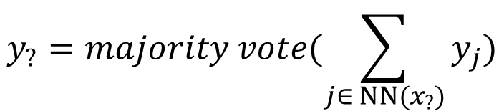

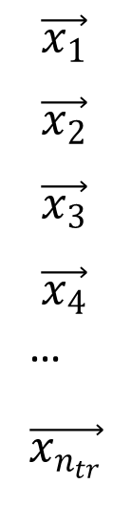
K-Nearest Neighbor Classifiers
$$z_{1 } { z}_{2}{ … z}_{p} Y$$
O(n_{tr} P)
Step1:
Step2:
Pick top k from n_{tr}
Step3:
$$\left\{\begin{aligned}d( \vec{x_{?}},\vec{x_{1}} ) \\ d(\vec{ x_{?}},\vec{x_{2}} ) \\ … \\ d(\vec{ x_{?}},\vec{x_{n_{tr}} } )\end{aligned}\right.$$
$$\vec{x_{1}}$$
$$\vec{x_{2}}$$
$$\vec{x_{3}}$$
$$\vec{x_{4}}$$
…
$$\vec{x_{n_{tr}}}$$
O(n_{tr} )
$$y_{?}=majority vote(\sum_{j∈ NN(x_{?})}{y_{j})}$$

Slide 22
K-Nearest Neighbor: How to decide
Decision of output value is delayed till a new instance arrives
Target variable may be discrete or real-valued
When target is discrete, the naïve prediction is the majority vote

Slide 23
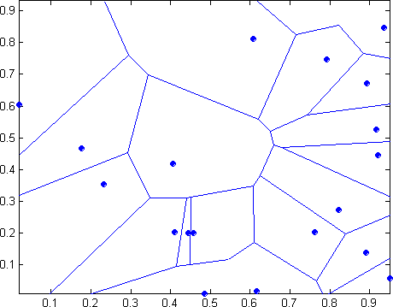
e.g. 1-Nearest Neighbor
x₂
Voronoi diagram:
partitioning of a plane into regions based on distance to points in a specific subset of the plane.
x₁

Slide 24
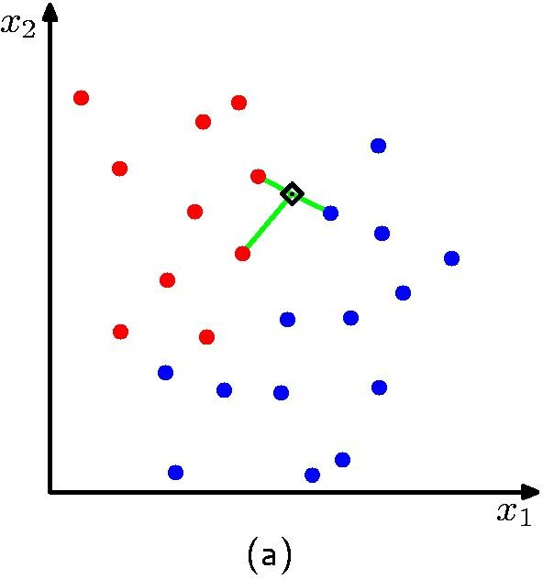
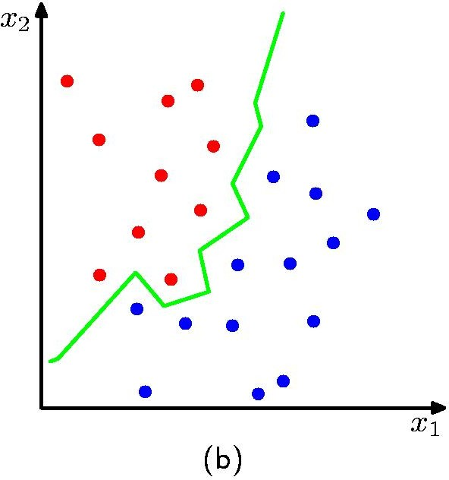
e.g. Decision boundary implemented by 3NN
The boundary is always the perpendicular bisector of the line between two points (Vornoi tesselation)
k-nearest neighbors of a sample x are datapoints
that have the k smallest distances to x

Slide 25
K-Nearest Neighbor: How to decide
Decision of output value is delayed till a new instance arrives
Target variable may be discrete or real-valued
When target is discrete, the naïve prediction is the majority vote
When target is continuous, the naïve prediction is the mean value of the k nearest training examples

Slide 26
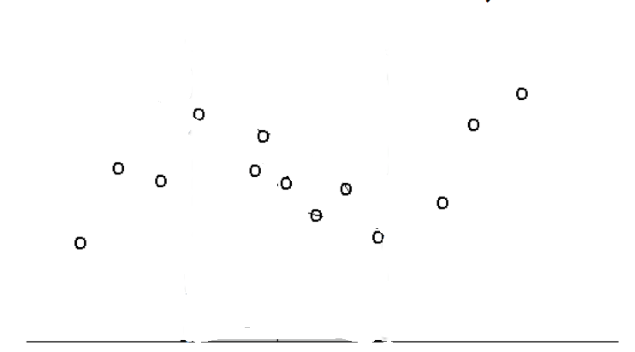
Nearest Neighbor (1D input) for Regression
y
x

Slide 27
5-Nearest Neighbor (1D input) for Regression
y
x

Slide 28
5-Nearest Neighbor (1D input) for Regression
y
x

Slide 29
5-Nearest Neighbor (1D input) for Regression
k = 5
x

Slide 30
Probabilistic Interpretation of KNN
Estimate conditional probability Pr(y|x)
Count of data points in class y in the neighborhood of x

Slide 31

Summary of Nearest neighbor methods
For regression, average the predictions of the K nearest neighbors.
For classification, pick the class with the most votes.
How should we break ties?
E.g. Let the k’th nearest neighbor contribute a count that falls off with k. For example,
$$1+ \frac{1}{2^{k}}$$

Slide 32
What makes an Instance-Based Learner?
A distance metric
How to relate to the local points?
How many nearby neighbors to look at?
A weighting function (optional)

Slide 33
1-Nearest Neighbor (kNN) Classifier
Sports
Science
Arts

Slide 34
2-Nearest Neighbor (kNN) Classifier
Sports
Science
Arts

Slide 35
3-Nearest Neighbor (kNN) Classifier
Sports
Science
Arts

Slide 36
5-Nearest Neighbor (kNN) Classifier
Sports
Science
Arts

Slide 37
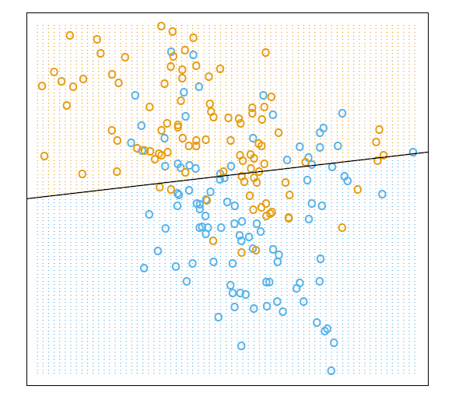
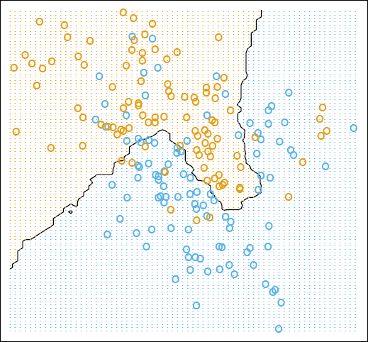
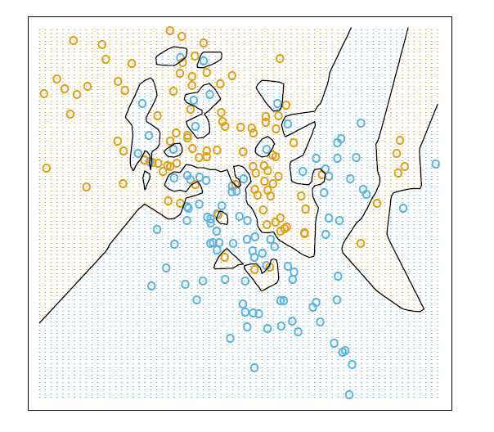
Decision boundaries in Linear vs. kNN models (Later)
linear classifier
15-nearest neighbor
1-nearest neighbor
Low Variance / High Bias
Linear classifier
global
stable
can be inaccurate
KNN
local
accurate
unstable
Low Bias
/ High Variance
What ultimately matters: Generalization

Slide 38
Model Selection for Nearest neighbor classification
Choosing the value of k:
If k is too small, sensitive to noise points
If k is too large, neighborhood may include points from other classes
Bias and variance tradeoff
A small neighborhood → large variance → unreliable estimation
A large neighborhood → large bias → inaccurate estimation

Slide 39
What makes an Instance-Based Learner?
A distance metric
How to relate to the local points?
How many nearby neighbors to look at?
A weighting function (optional)

Slide 40
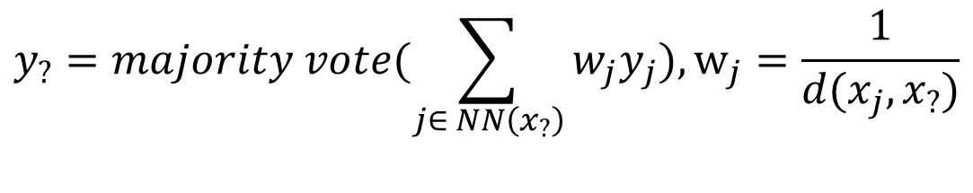
Nearest neighbor Variations
Options for determining the class from nearest neighbor list
majority vote of class labels among the k-nearest neighbors
Weight the votes according to distance
example: weight factor w = 1 / d²
Spurious or less relevant points need to be downweighted
$$y_{?}=majority vote(\sum_{j∈ NN\left(x_{?}\right)}{{w_{j}y}_{j}}),w_{j}=\frac{1}{d(x_{j}, x_{?})}$$

Slide 41



















Another Weighted kNN
Weight the contribution of each close neighbor based on their distances
Weight function
Prediction

Slide 42
Variants: Distance-Weighted k-Nearest Neighbor Algorithm
Assign weights to the neighbors based on their “distance” from the query point
Weight “may” be inverse square of the distances
w = 1 / d²
Extreme Option: All training points may influence a particular instance
E.g. Shepard’s method/ Modified Shepard, … by Geospatial Analysis

Slide 43
Computational Time Cost
 | Train(n) | Test(m=1)
Linear Regression | O(np²+p³) | O(p)
KNN | O(1) | O(np)+O(sort n-k)
P=30,000
N=20,000

Slide 44
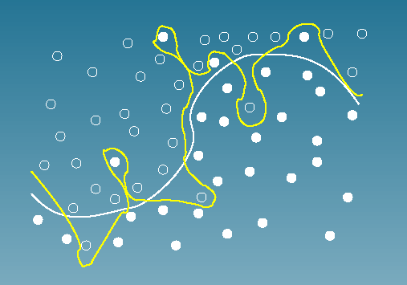
Is kNN ideal?

Slide 45
References
https://qiyanjun.github.io/2019f-UVA-CS6316-MachineLearning/
https://www.wikipedia.org/

Slide 46
Thanks for listening

